Slide 1


INSTITUTE FOR ADVANCED COMPUTING AND SOFTWARE DEVELOPMENT AKURDI, PUNE
Documentation On
“New York Taxi Fare Price Prediction”
PG-DBDA Mar 2022
Submitted By: Group No: 13
Harshita Paliwal 223322
Akash Hingane 223323
Mr. Prashant Karhale
Centre Coordinator
Mr. Akshay Tilekar
Project Guide

Slide 2
Introduction
Aim And objective - New York City Taxi Fare Price Prediction
The primary objective of this project is to predict fare price throughout New York City as it changes from day to day and hour to hour. So, given a specific location, time and passenger count we will predict the taxi fare price for a trip .
We are going to achieve above objective by developing a web interface for end user to predict the fare amount for a taxi ride in New York City on giving the time, number of passenger, pickup and drop-off locations.
Predicting fare can help passengers decide when is the optimal time to start their commute, or help drivers to decide which of the potential rides will be more profitable.

Slide 3
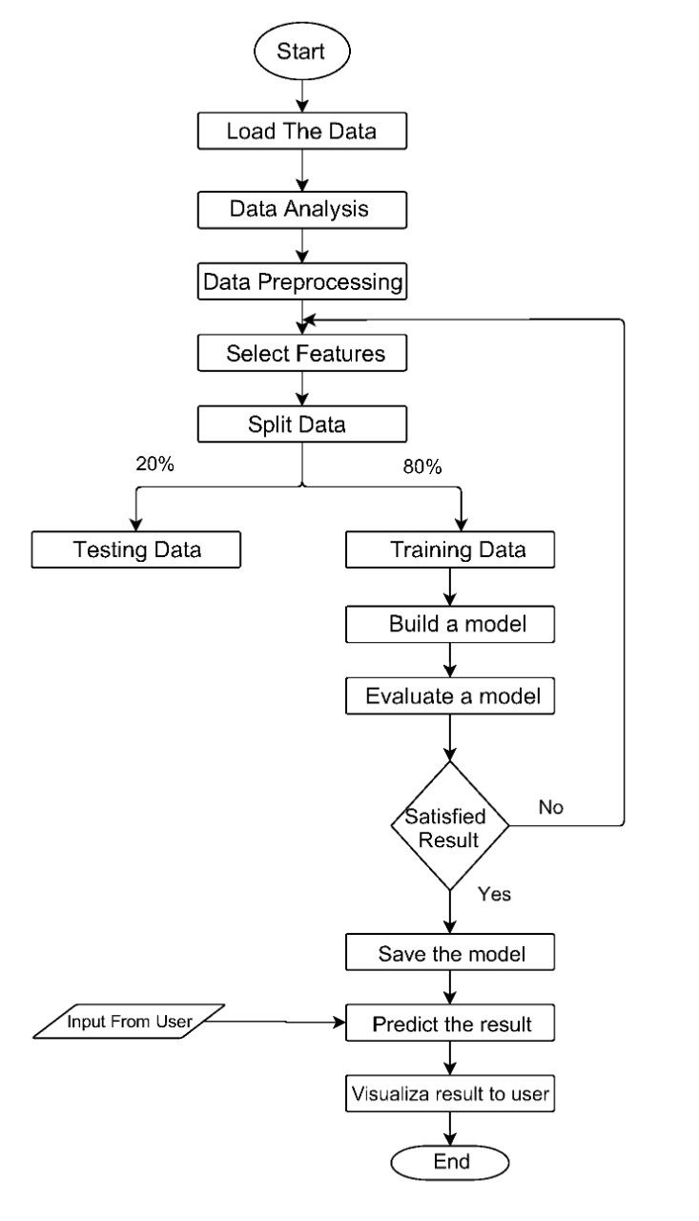
Workflow of project -

Slide 4
Dataset Description -
Kaggle Dataset – Playground Prediction Competition, hosted in partnership with Google Cloud and Coursera, tasked with predicting the fare amount for a taxi ride in New York City given the pickup and drop-off locations of 50 millions transactions.
https://www.kaggle.com/competitions/new-york-city-taxi-fare-prediction/data?select=train.csv
 | Feature name | Explanation
Dependent variable (y) | fare_amount | Cost of the taxi ride in dollars. This is the value to be predicted.
Independent variable (x) | pickup_datetime | pickup date and time information
 | pickup_longitude | pickup longitude coordinates in decimals
 | pickup_latitude | pickup latitude coordinates in decimals
 | dropoff_longitude | drop-off longitude coordinate in decimals
 | dropoff_latitude | drop-off latitude coordinate in decimals
 | passenger_count | Number of passengers in taxi

Slide 5
Data preprocessing and cleaning -
1. Loading the dataset
2. Analysis of data
3. Split data
4. Preprocess data
5. Sample of preprocessed data
6. Merge data

Slide 6
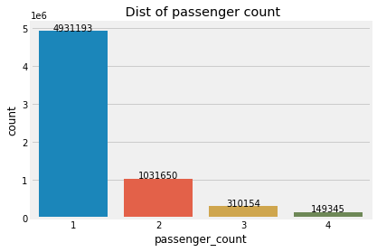
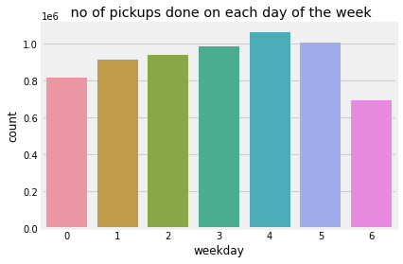
Exploratory Data Analysis
Above figures showing that passengers mostly selecting the solo trip over the group trip and its shows that on Thursday there are more pickups followed by Friday.

Slide 7
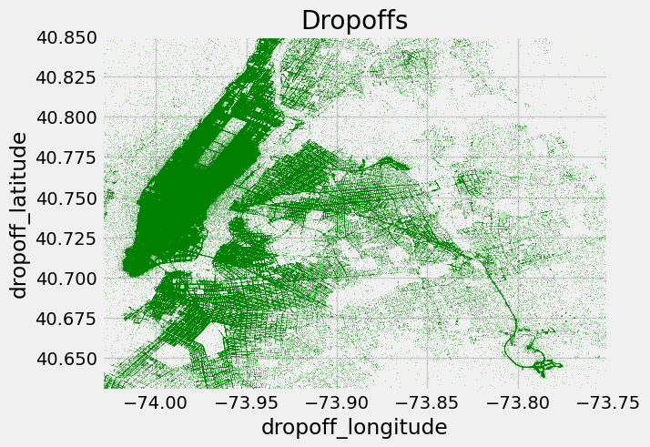
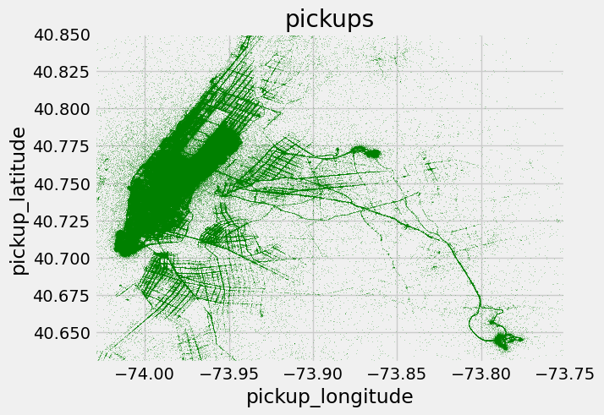
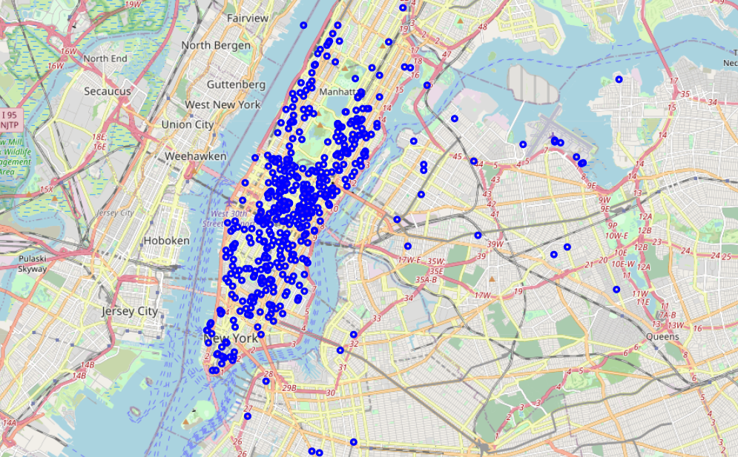
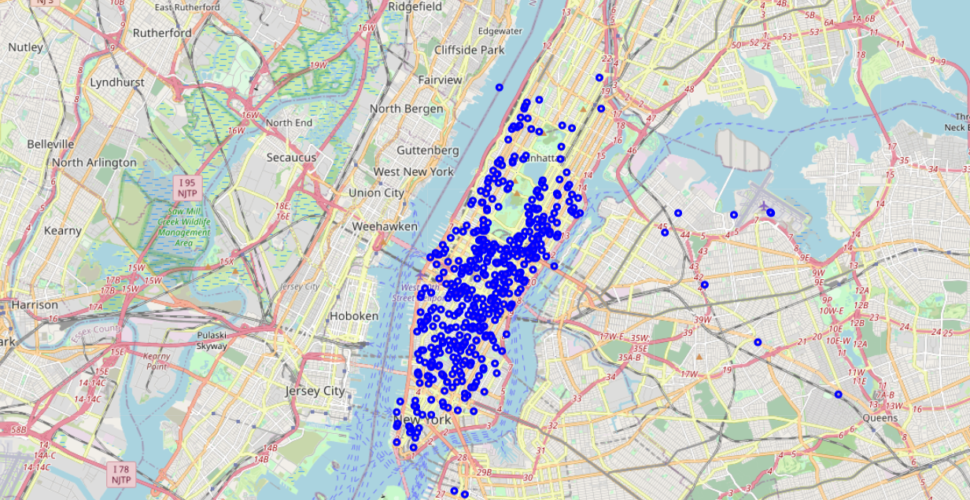
We considered the New York city longitude (-75 to -72) and latitude (40 to 42) range as above figure shows the most used locations for pickups and drop-offs.

Slide 8
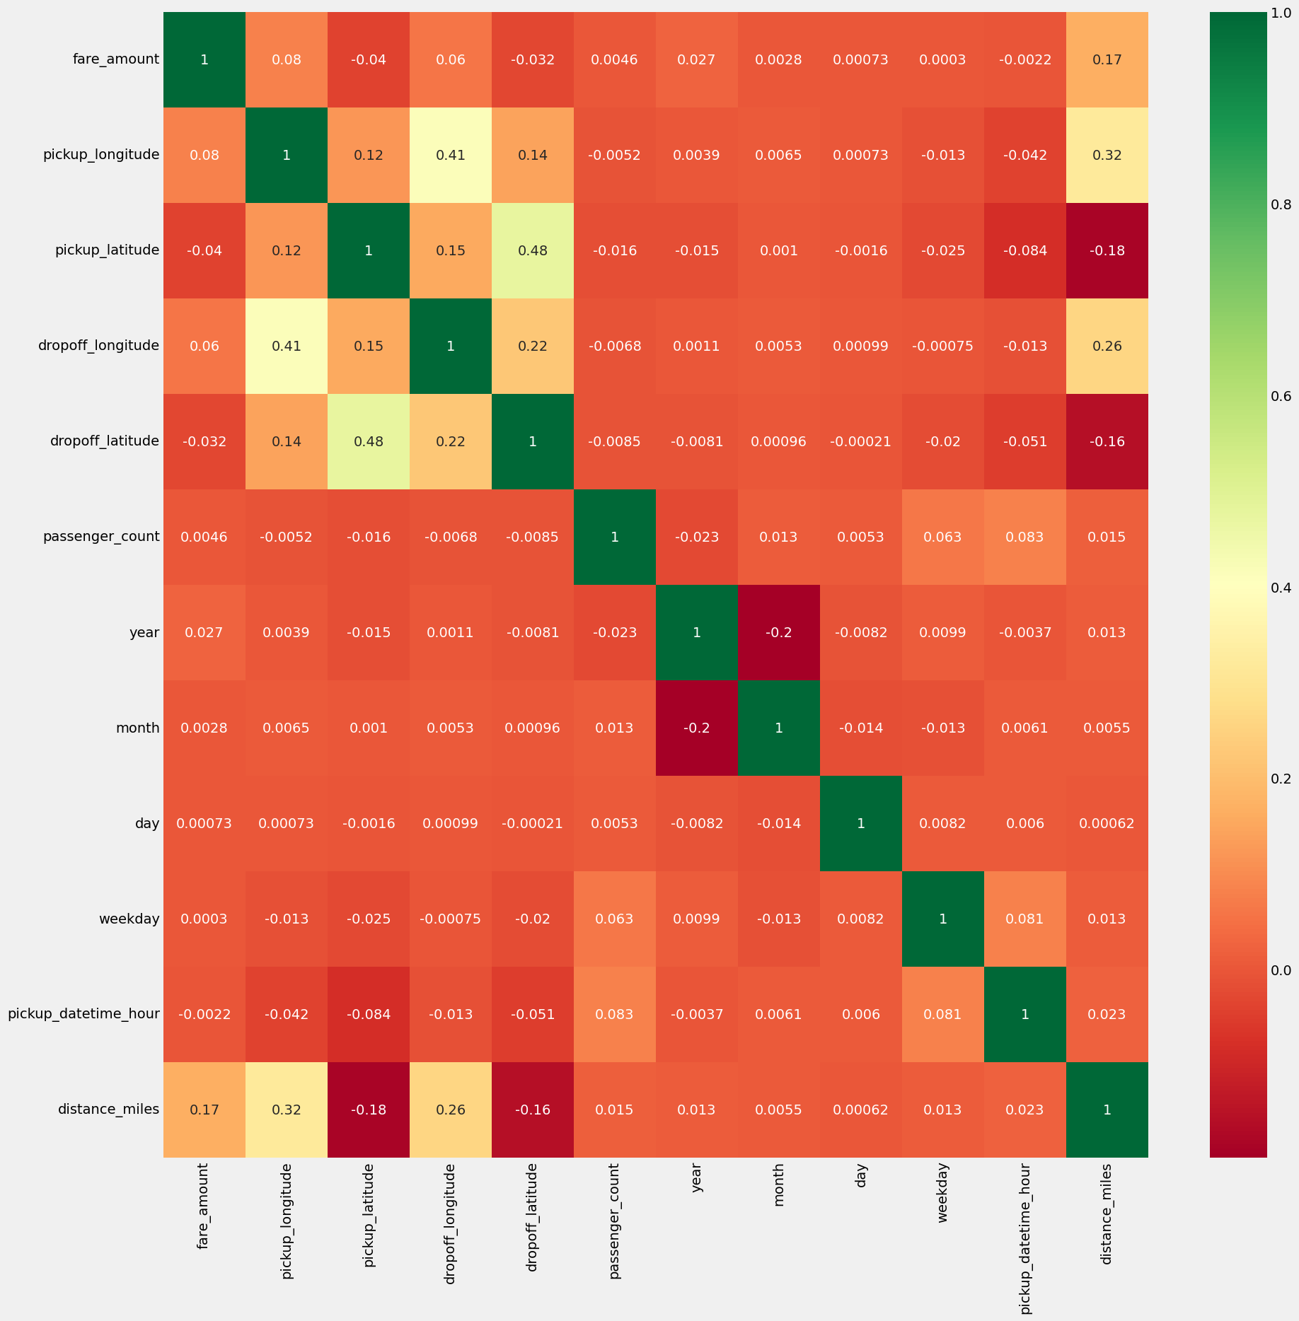
This fig is of heat map it shows the relation between dependent feature and independent features.
 | Feature | Corr() coefficient | Correlation in %
Dependent Variable | fare_amount | 1.000000 | 100%
Independent Variables | pickup_longitude | 0.080057 | 8 %
 | pickup_latitude | -0.039722 | -3.9 %
 | dropoff_longitude | 0.059824 | 5.9%
 | dropoff_latitude | -0.032449 | -3.2 %
 | passenger_count | 0.004641 | 0.4 %
 | year | 0.027288 | 2.7 %
 | month | 0.002797 | 0.27 %
 | day | 0.000729 | 0.072 %
 | weekday | 0.000301 | 0.03 %
 | pickup_datetime_hour | -0.002159 | -0.2 %
 | distance_km | 0.167923 | 16.79 %

Slide 9
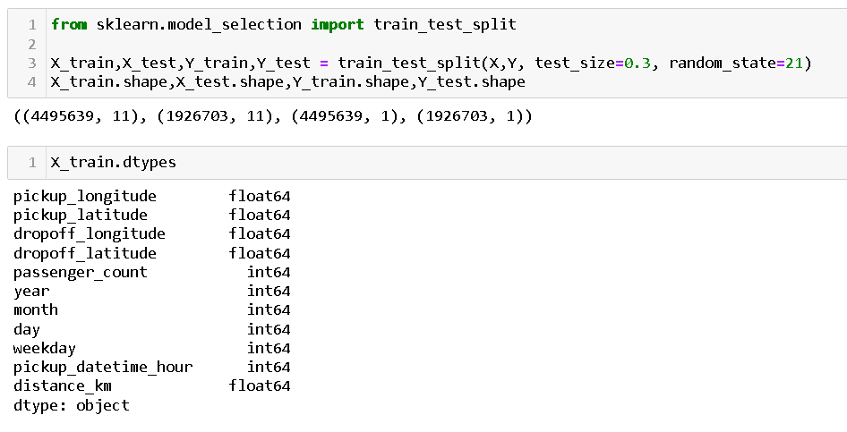
Regression Models
Model Building:
Loading Dataset -
# loading dataset from local
df = pd.read_csv('EDA_data.csv’)
X, Y Split -
X= df.drop(['fare_amount','pickup_datetime','Unnamed: 0'],axis=1)
Y= df[['fare_amount']]
Train/Test Split -

Slide 10
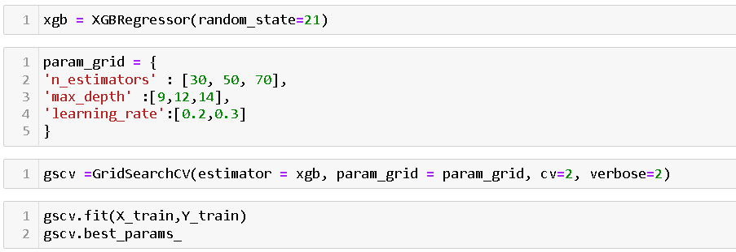
Model 1 - XGBOOST Regressor
Importing the Required libraries
Hyper-parameter Tunning – GridSerachCV

Slide 11
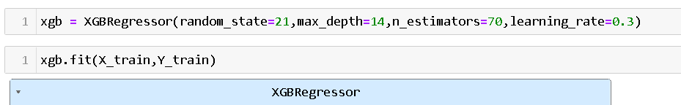
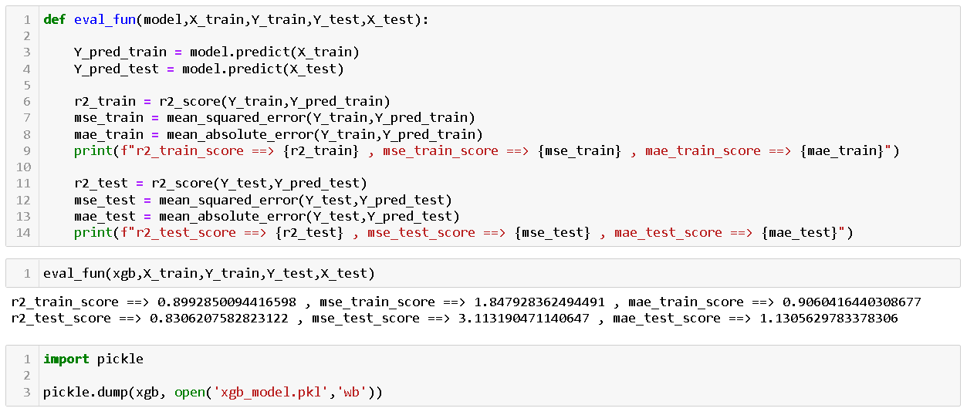
Applying best parameters to XGB model
Model Evaluation
Result –
XGBOOST model giving R2 score for train dataset – 89.92 % and for testing – 83.06%

Slide 12
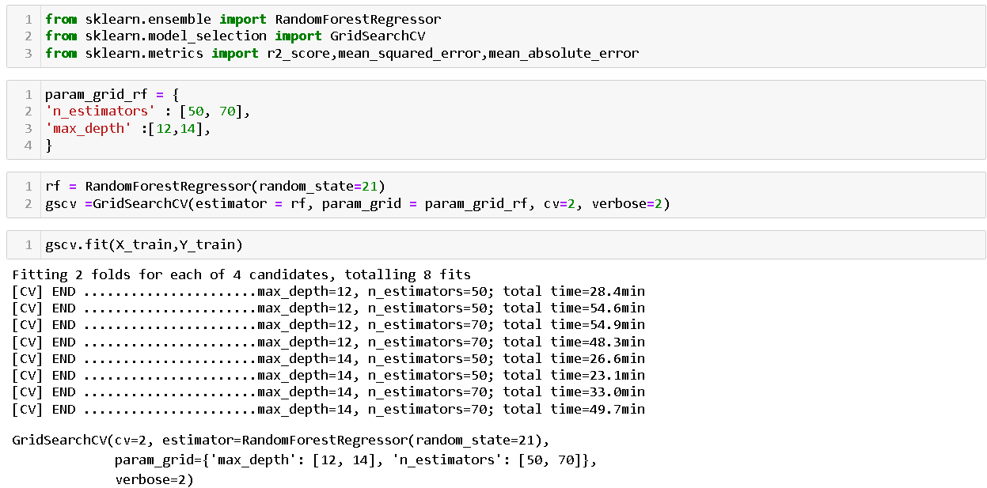
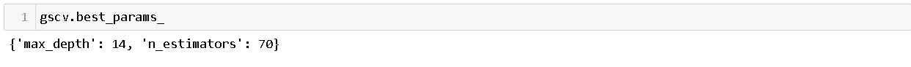
Model 2 – Random Forest Regressor
Importing the Required libraries
Hyper-parameter Tunning – GridSerachCV

Slide 13
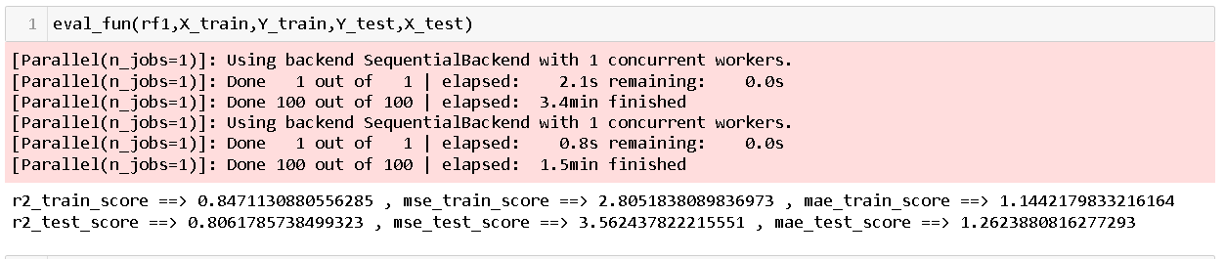
Applying best parameters to RF model
Model Evaluation
Result –
Random Forest model giving R2 score for train dataset – 84.71 % and for test dataset – 80.6%

Slide 14
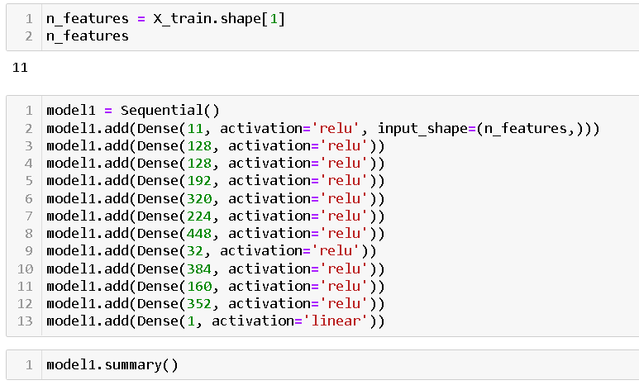
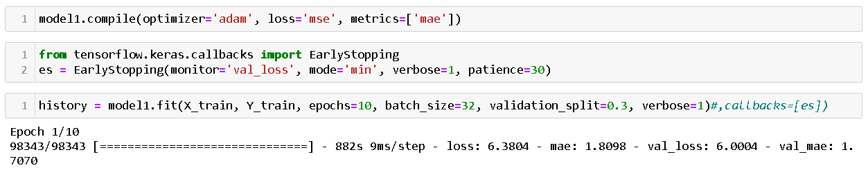
Model 3 – Artificial Neural Network
Applying ANN model

Slide 15
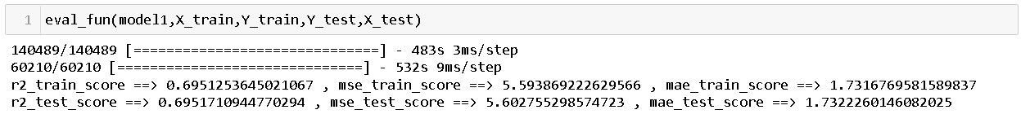
Model Evaluation
Result –
ANN model giving R2 score for train dataset – 69.5 % and for test dataset – 69.5%

Slide 16
Model Comparison
 | Train |  |  | Test
Model | R2 score | MSE | MAE | R2 score | MSE | MAE
XGBOOST | 0.89 | 1.847 | 0.906 | 0.83 | 3.14 | 1.13
Random Forest | 0.84 | 2.809 | 1.14 | 0.80 | 3.566 | 1.263
ANN | 0.69 | 5.5938 | 1.73 | 0.69 | 5.5938 | 1.73
The XGBoost model outperform all other models used, as it manages to score high on training and testing dataset.
XGBoost model giving higher prediction accuracy of 89 % for train dataset and 83 % for test dataset ,
So we concluded that this model is more efficient and reliable in predicting the fare price.

Slide 17
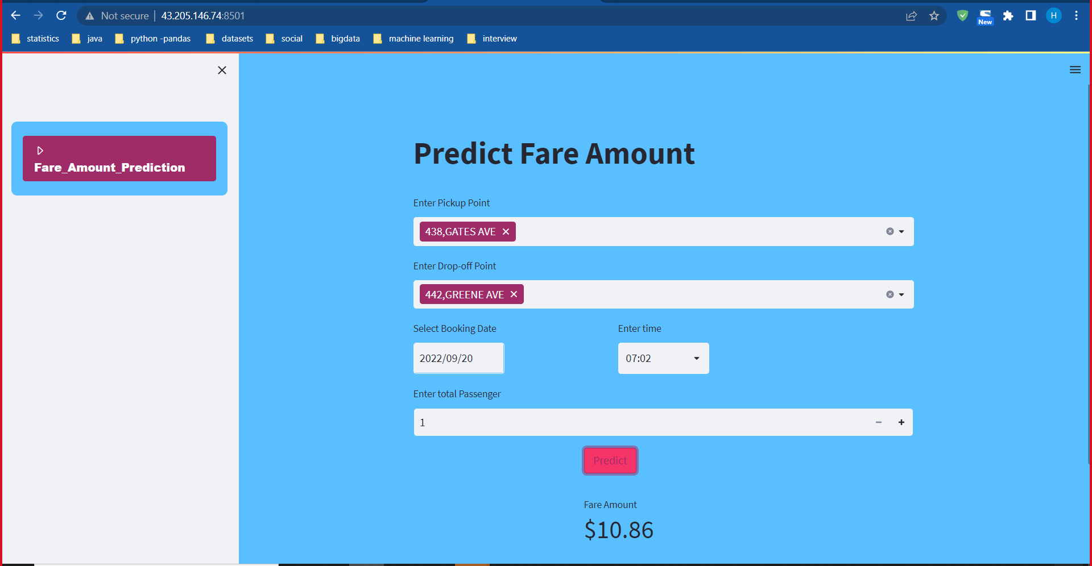
User Interface
Streamlit
We used Streamlit API to create User Interface
Streamlit is an open-source app framework in Python language.
Streamlit allows you to write an app the same way you write a python code.
There are five inputs given by user to predict fare amount :
1.Pickup point
2.Dropoff Point
3.Booking Date
4.Booking time
5.Passanger count

Slide 18
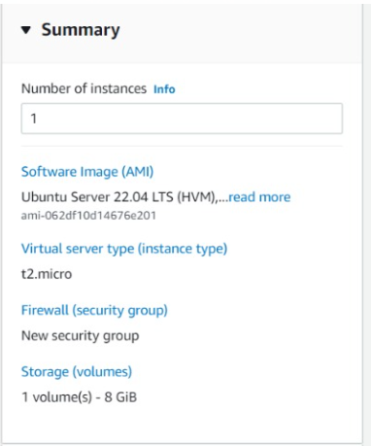
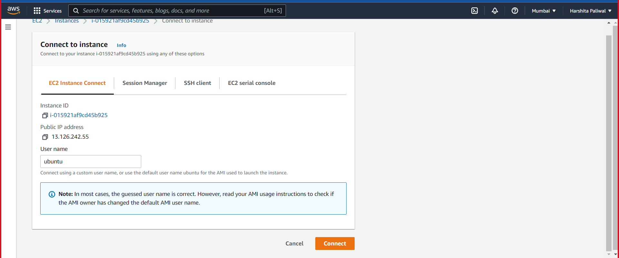
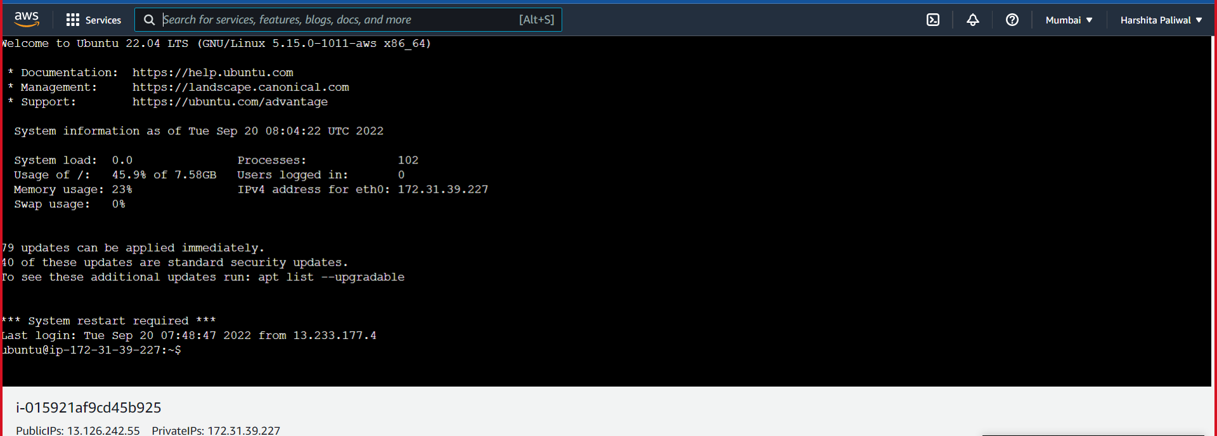
Connecting to EC2 instance
Deployment On AWS Cloud Platform
Creating a new EC2 instance

Slide 19
Library Setup Commands
ubuntu@ip-172-31-39-227:~$ sudo apt-get update
ubuntu@ip-172-31-39-227:~$ sudo apt-get install python3
ubuntu@ip-172-31-39-227:~$ sudo apt-get install python3-pip
ubuntu@ip-172-31-39-227:~$ pip3 install --upgrade pip
ubuntu@ip-172-31-39-227:~$ cat requirements.txt
pandas
scikit-learn
Streamlit
NumPy
streamlit_option_menu
ubuntu@ip-172-31-39-227:~/4_application$ pip3 install -r requirements.txt
ubuntu@ip-172-31-39-227:~/4_application$ sudo pip3 install xgboost
ubuntu@ip-172-31-39-227:~/4_application$ streamlit run main.py

Slide 20
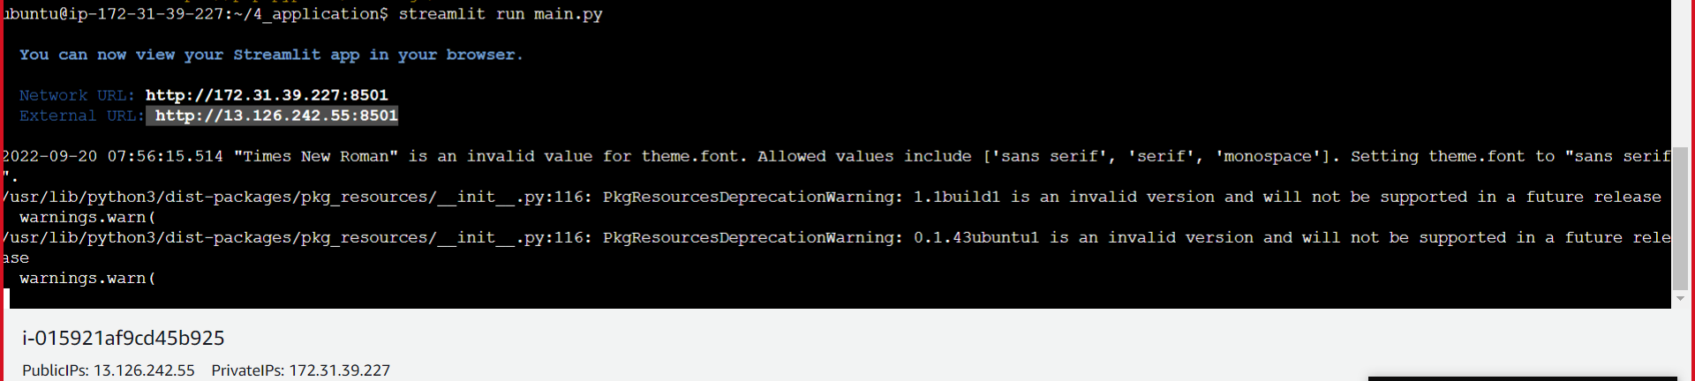
Running Streamlit Application

Slide 21
User Interface

Slide 22
References
https://www.kaggle.com/competitions/new-york-city-taxi-fare-prediction/data
https://www.geeksforgeeks.org/
https://pandas.pydata.org/pandas-docs/version/0.23/api.html
https://www.youtube.com/
https://scikit-learn.org/stable/supervised_learning.html#supervised-learning
https://streamlit.io/

Slide 23
Thankyou

